Slide 1
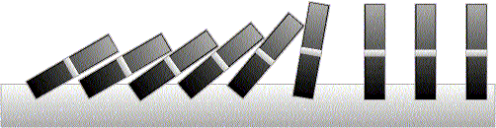
About the Course
A
B
C

Slide 2
Course Material
Reference Books:
  Discrete Mathematics with Applications, Susanna S. Epp
  Schaum's Outline of Discrete Mathematics
  Discrete Mathematics and its Applications, by Kenneth H. Rosen

Slide 3
Why Mathematics?
Design efficient computer systems.
How did Google manage to build a fast search engine?
What is the foundation of internet security?
algorithms, data structures, database,
parallel computing, distributed systems,
cryptography, computer networks…
Logic, number theory, counting, graph theory…

Slide 4
Discrete Mathematics
What is discrete mathematics?
discrete mathematics
continuous mathematics
integers
real numbers
graphs
geometric space
induction
calculus
logic
These two areas are not disjoint, e.g. calculus can be
used to solve discrete problems (generating functions).

Slide 5
Discrete Mathematics
Why discrete mathematics?
In computer science we usually deal with finite, discrete objects. For example,
we cannot store a real number (infinite precision) in a computer but can only
store bits (finite precisions).
we often model a computer network as a graph, and use the knowledge and
techniques in dealing with graphs to solve problems in networks.
The problems and the techniques are often different (e.g. induction, recursion).

Slide 6
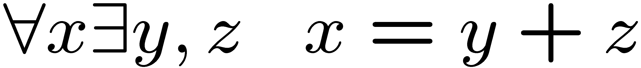
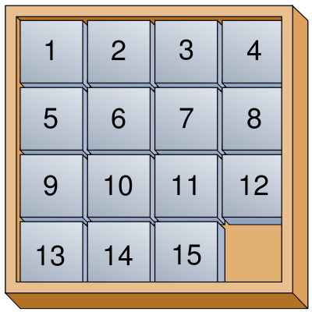

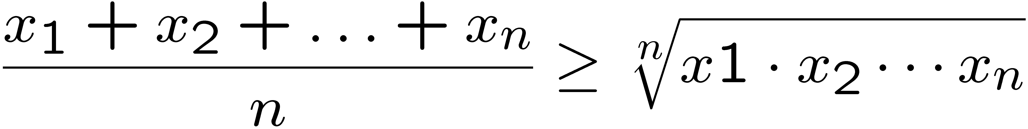
Topic: Logic and Proofs
How do computers (and humans) think?
Logic: propositional logic, first order logic
Proof: induction, contradiction
Applications: artificial intelligence, database, circuit, algorithms
Objective: to reason rigorously and learn basic proof techniques (e.g. induction)

Slide 7
Topic: Graph Theory
Graphs
Degree sequence, Eulerian graphs, isomorphism
Trees
Matching
Coloring
Applications: Computer networks, circuit design, data structures

Slide 8
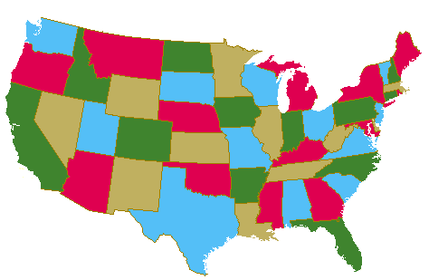



Topic: Graph Theory
How to color a map?
How to schedule exams?
How to send data efficiently?
Objective: to model problems and learn basic concepts and knowledge

Slide 9
Topic: Counting
Sets and Functions
Combinations, Permutations, inclusion-exclusion
Counting by mapping, pigeonhole principle
Recursions, generating functions
A
B
C
Applications: probability, data structures, algorithms
Objective: to learn basic concepts (set, functions) and fundamental techniques.

Slide 10
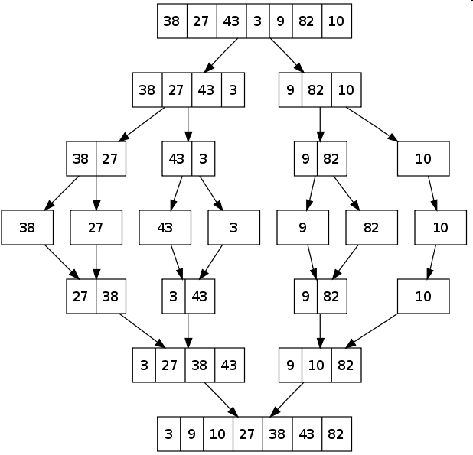
Topic: Counting
How many steps are needed to sort n numbers?
Algorithm 1 (Bubble Sort):
Every iteration moves the i-th smallest number to the i-th position
Algorithm 2 (Merge Sort):
Which algorithm runs faster?

Slide 11
Objectives of This Course
To learn basic mathematical concepts, e.g. sets, functions, graphs
To be familiar with formal mathematical reasoning, e.g. logic, proofs
To improve problem solving skills, e.g. induction, recursion
To see the connections between discrete mathematics and computer science
Content Courtesy:
  Prof. Lap Chi Lau, CSE, CUHK
  Prof. Naveen Garg, IIT, Delhi

